Slide 1
Welcome to Kensington Palace

Slide 2
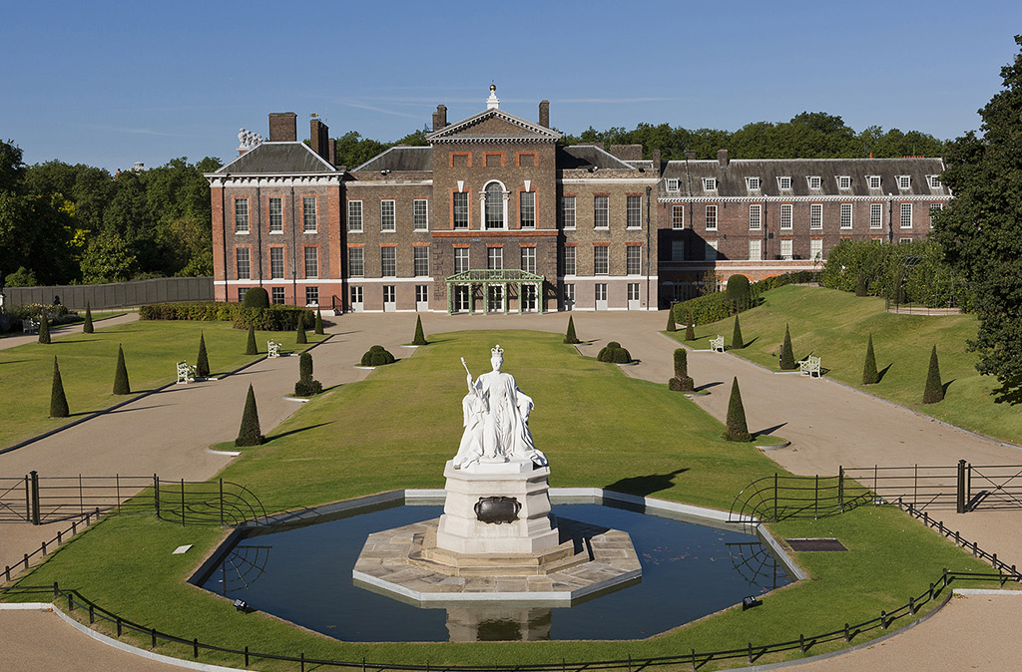
This is Kensington Palace.
Come and look inside.

Slide 3
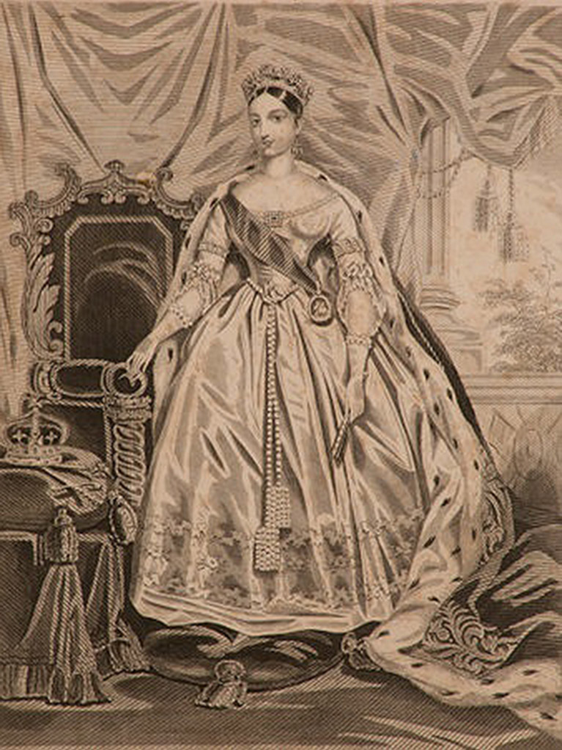
Queen Victoria lived at Kensington Palace 200 years ago.

Slide 4
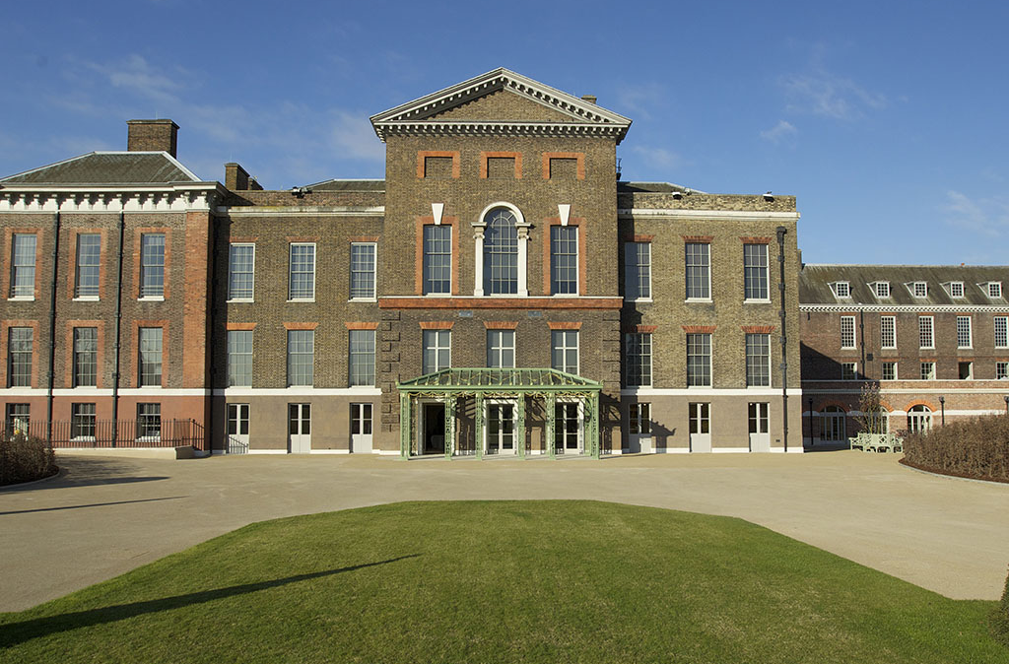
When you arrive you will first come to this green entrance.

Slide 5
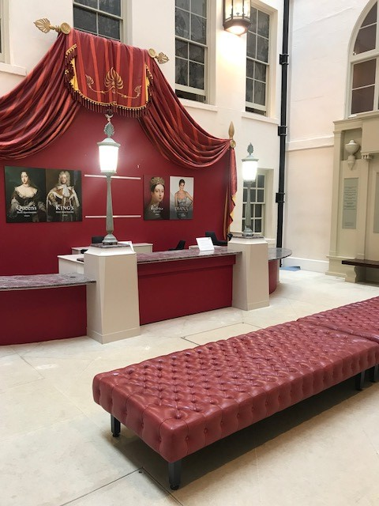
You can leave your coats and bags here. There is an accessible toilet nearby.

Slide 6
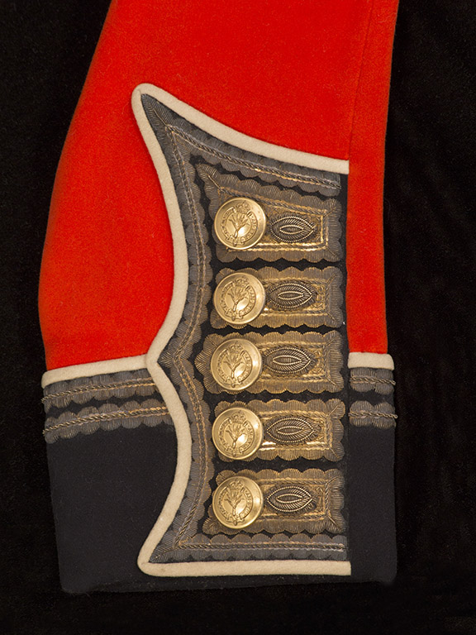
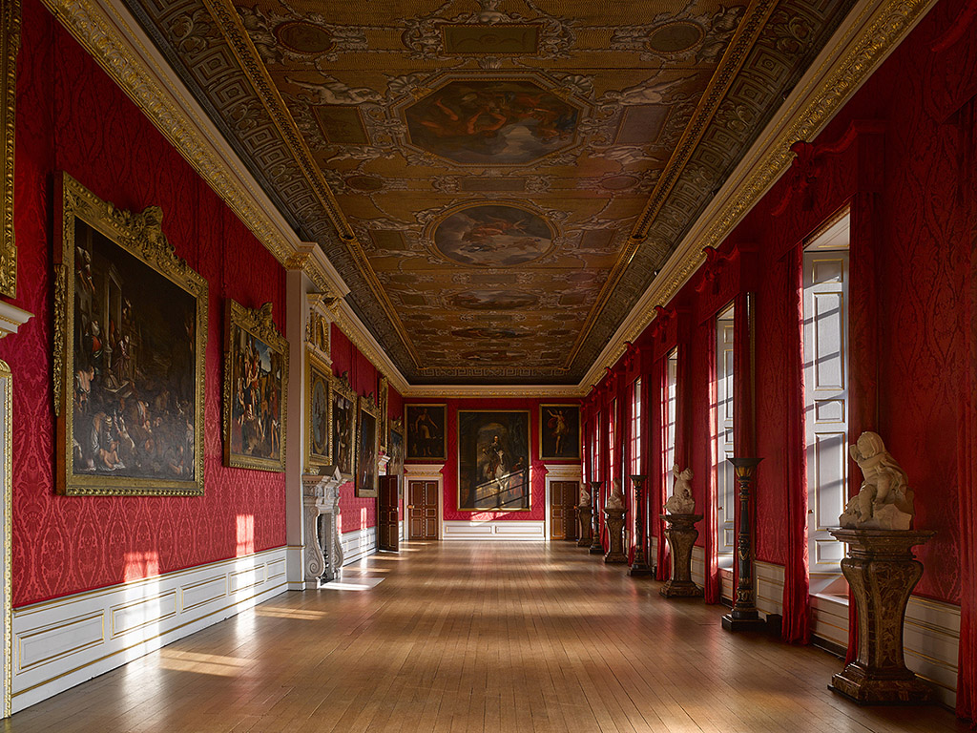
Many things at Kensington Palace are a red colour.

Slide 7
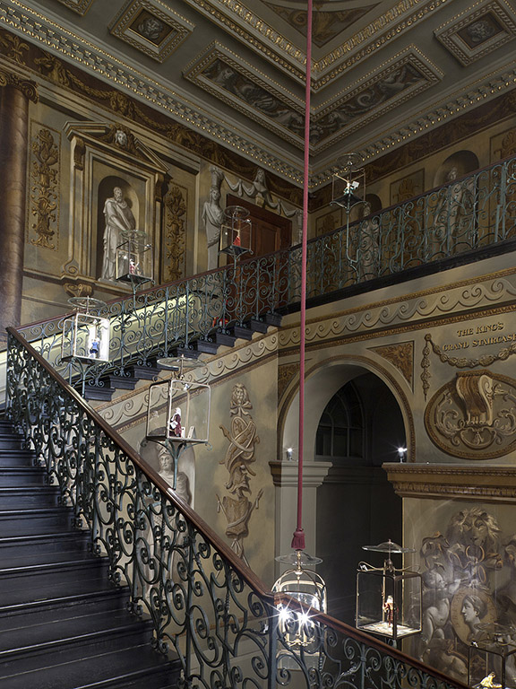
You will walk up these stairs.

Slide 8
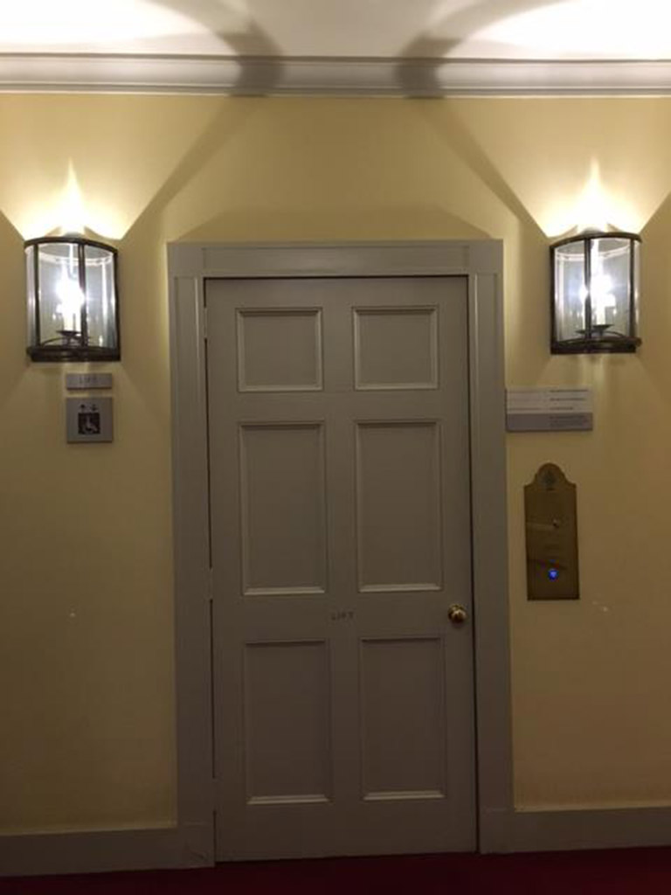
There is also a lift.

Slide 9
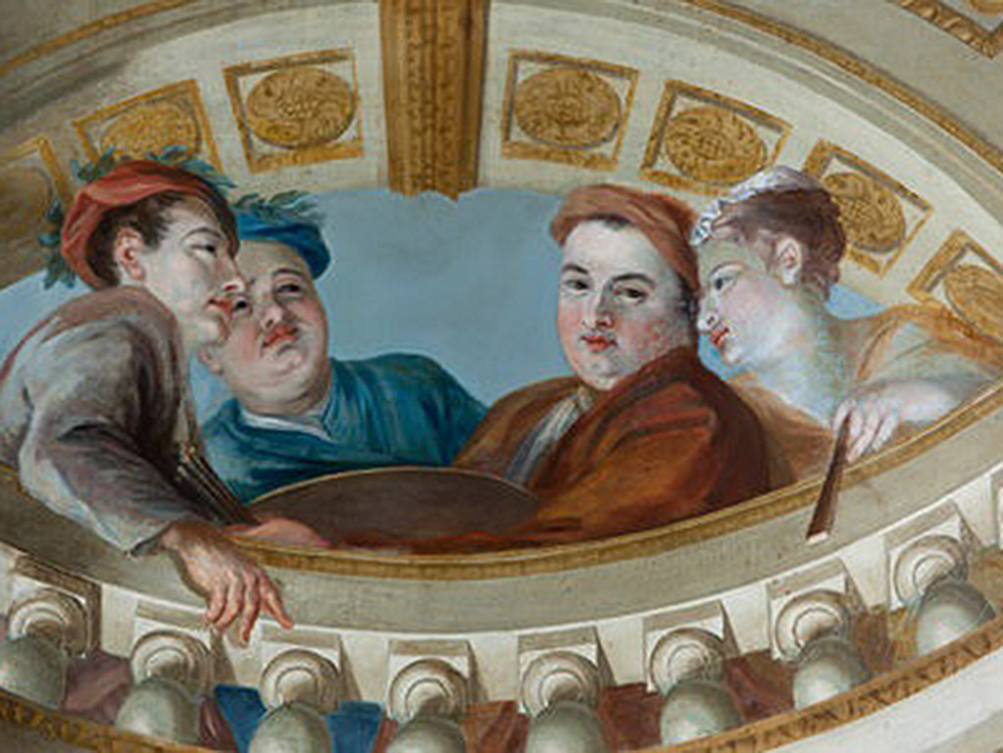
You can look up to see this.

Slide 10
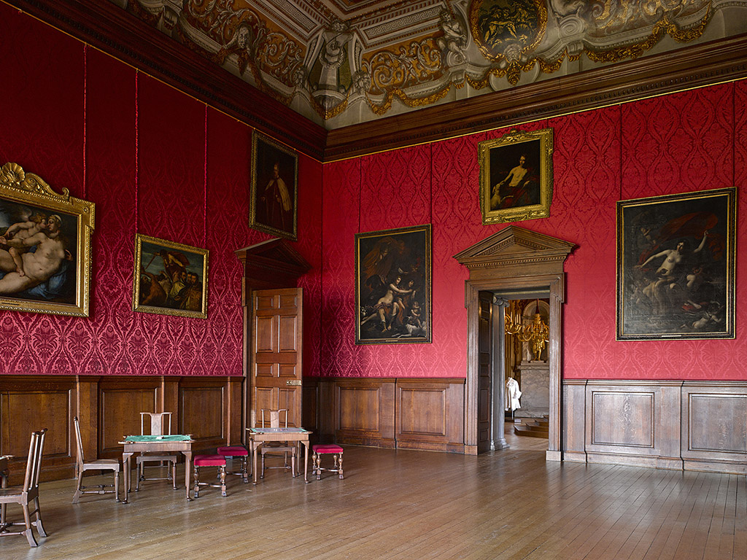
You will walk through this room.

Slide 11
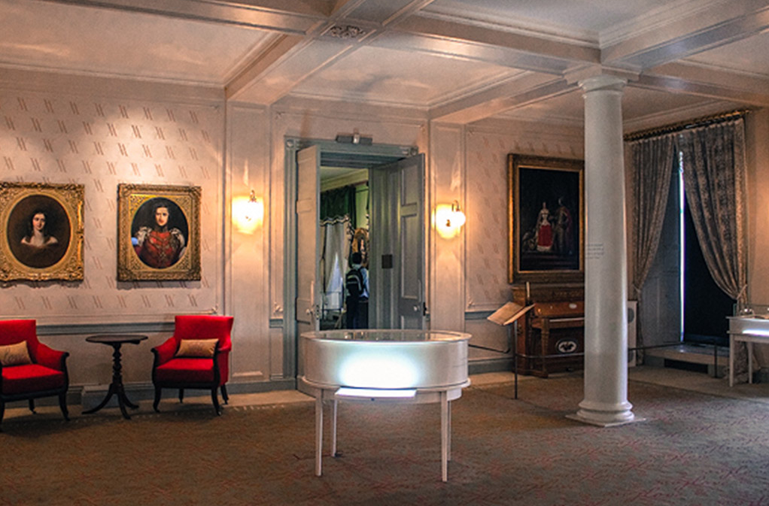
You will walk through to this room.

Slide 12
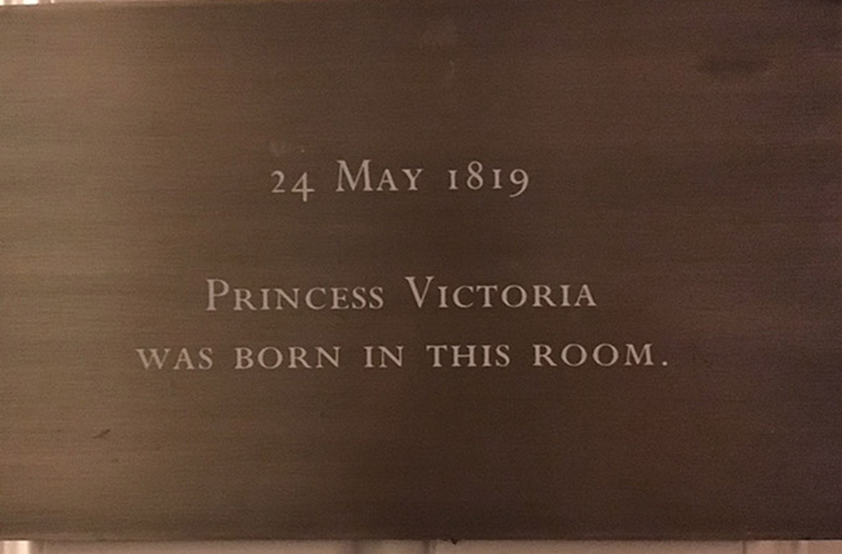
You will see this sign before you go into the next room.

Slide 13
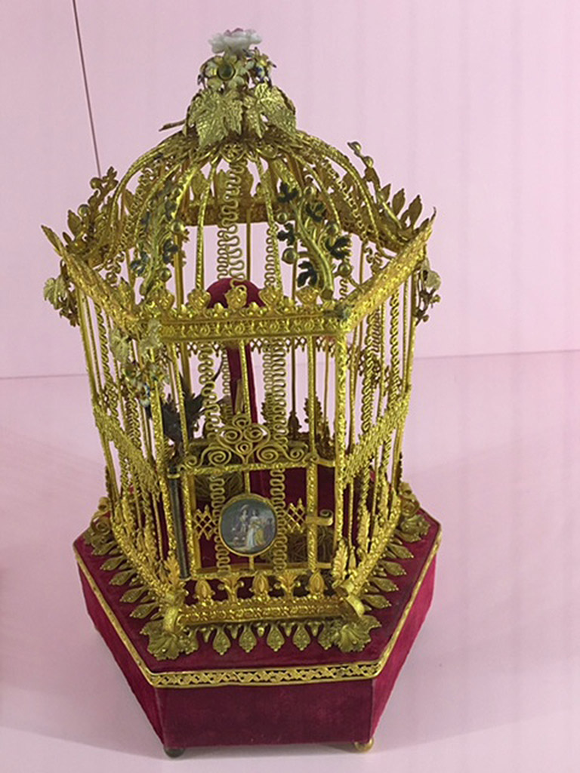
You might see this special object at Kensington Palace.

Slide 14
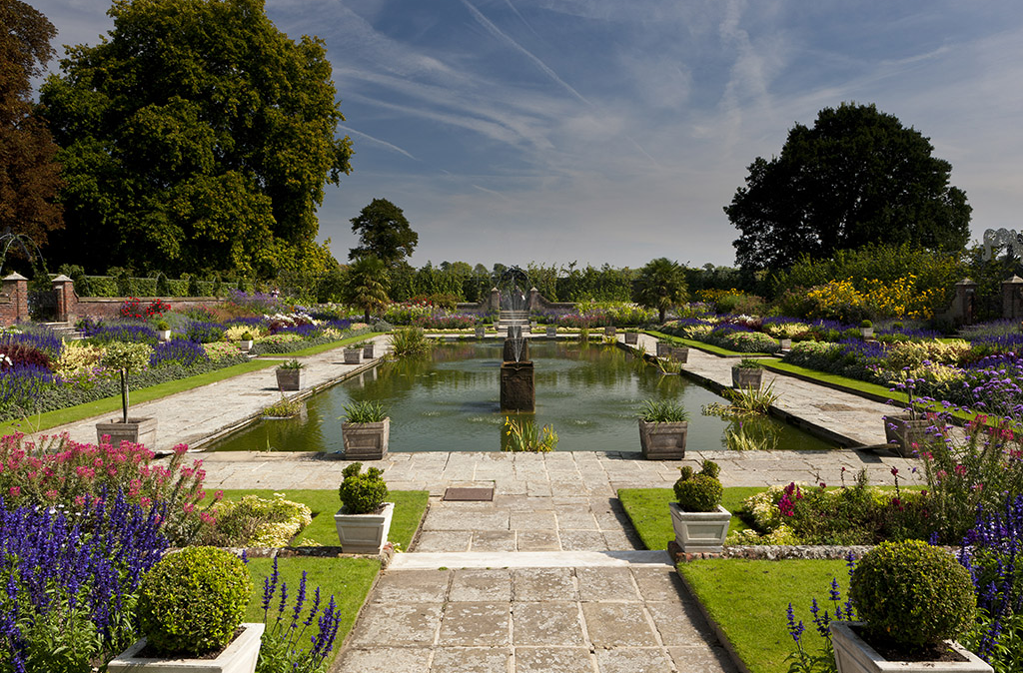
You can smell the flowers in the gardens and listen to the birds.

Slide 15
We hope you enjoy your visit.

